Slide 1
COMP6940: BIG DATA AND DATA VISUALISATION
LECTURE #1: DATA COLLECTION, EDA, CDA
Inzamam Rahaman

Slide 2
AGENDA
Data Collection
Methods – database, API, Web scraping
Advice for data cleaning
Exploratory Data Analysis
Useful strategies and techniques for EDA
Plots that are useful for EDA
Confirmatory Data Analysis
Use of confirmatory data analysis in machine learning and data science
Simple ypothesis testing – T-test, ANOVA, Tukey’s Test
Simple Regression Analysis

Slide 3
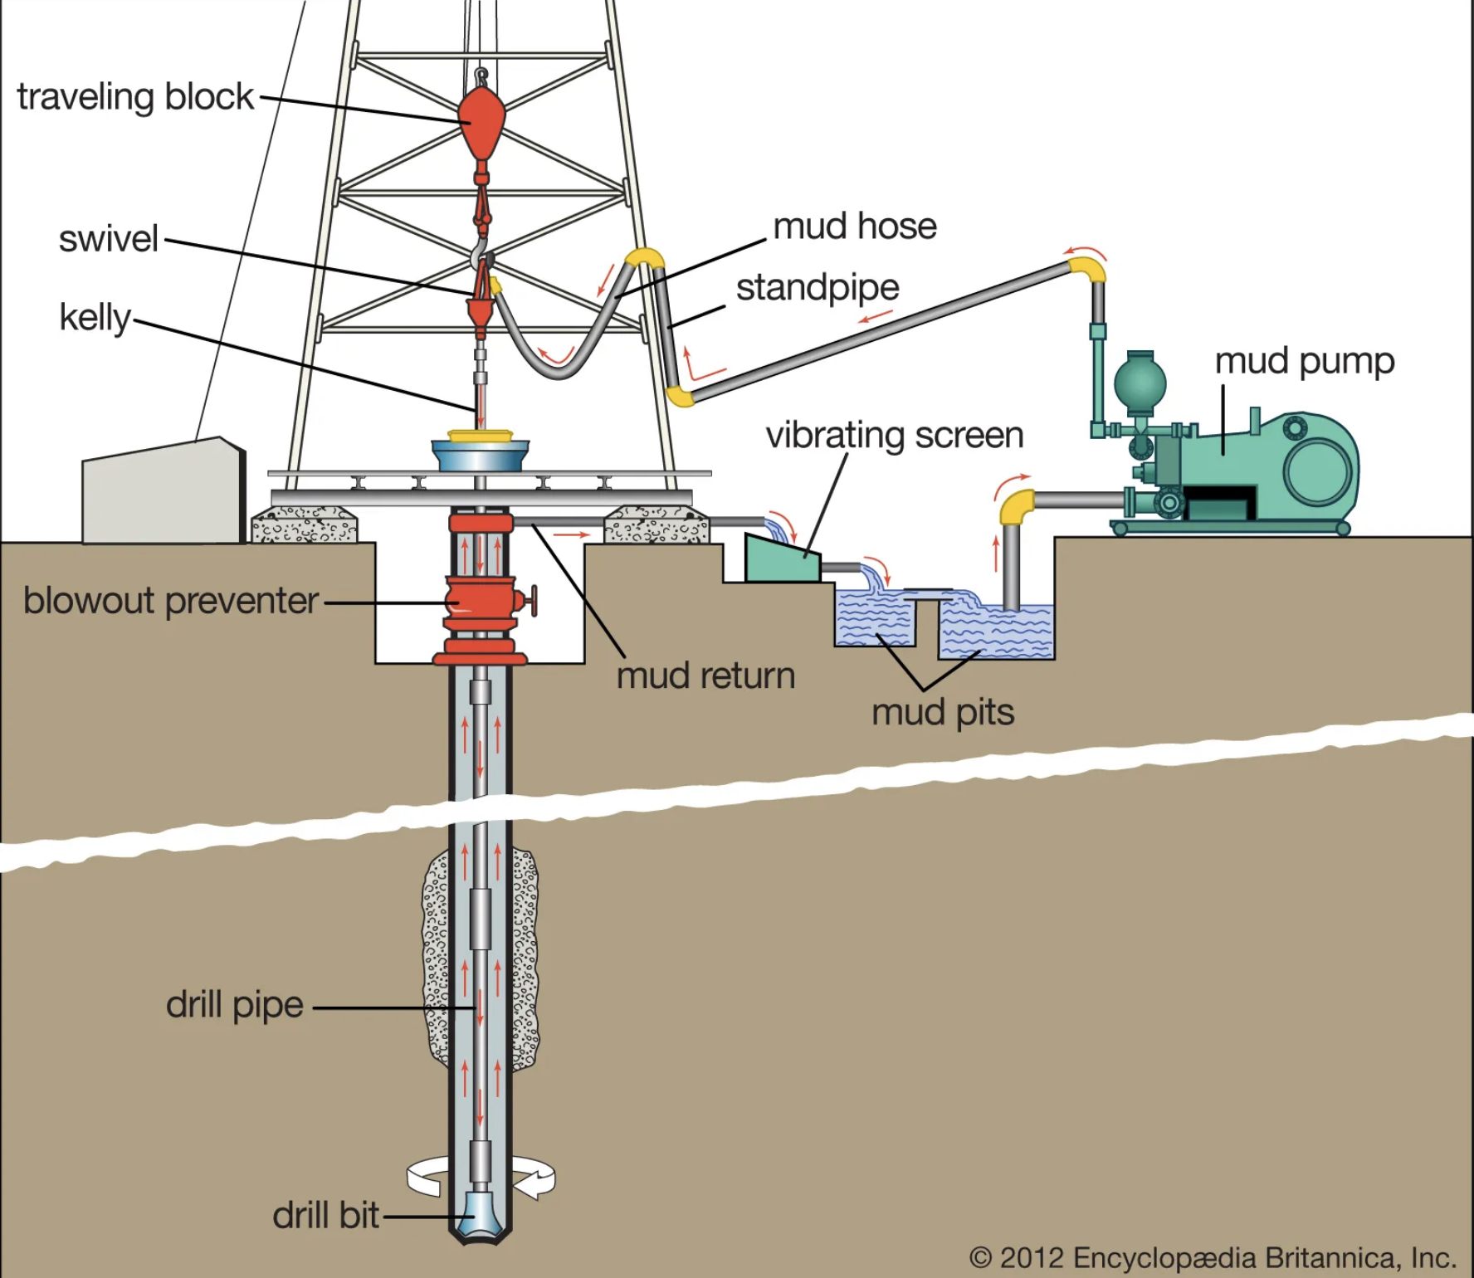
DATA COLLECTION
Just like petrochemicals, the first step in extracting value from data is extracting data from the “ground”
Typically, designing the ”wells” is not within the remit of the data scientist, but learning some additional database and software engineering might be useful
After the data has been extracted, it needs to undergo cleaning to enable further processing

Slide 4
DATA COLLECTION - METHODS
Data is housed in several formats and across different ”venues”
Each of these different venues has corresponding venues:
Machine-readable Flat files (e.g. CSVs, TSVs, .xlsx, JSON) – use the appropriate library (e.g. Pandas, Python JSON library) to read the file into the programme
Database or Data-warehouse (e.g. MySQL, SQLite, MongoDB, Snowflake) – use database connection library that allows for execution and retrieval of query results
Webservices – sometimes data is served by an API, e.g. USGS Earthquake data, Twitter API, that serves the data in a machine readable format, usually JSON
Website, PDF, or non machine-readable file – scraping (+ OCR)

Slide 5
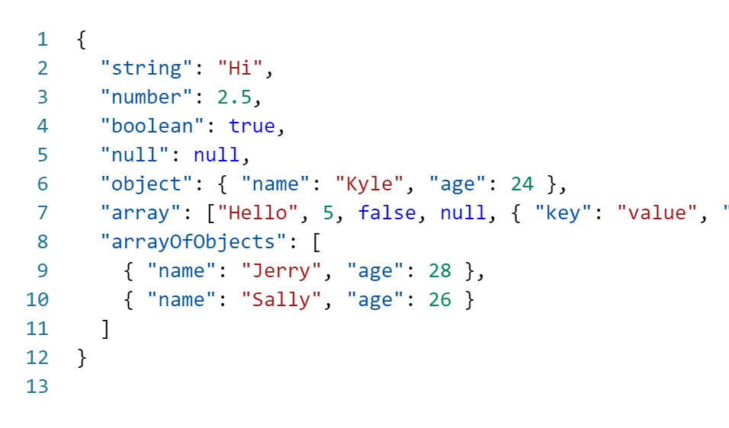
DATA COLLECTION - JSON
JSON – intialisation of JavaScript Object Notation
Used to represent objects in JavaScript programming language
It has evolved to become a cross-platform data exchange format
What XML was supposed to be, but a lot better
In Python, can use the integrated JSON library to process and use like a Python dictionary

Slide 6
DATA COLLECTION - JSON
Just like petrochemicals, the first step in extracting value from data is extracting data from the “ground”
Typically, designing the ”wells” is not within the remit of the data scientist, but learning some additional database and software engineering might be useful
After the data has been extracted, it needs to undergo cleaning to enable further processing

Slide 7

COURSE MOVITIVATION
Extracting usable products and insights from data is difficult engineering challenge
Large volumes of data “break” some traditional assumptions
Data storytelling is difficult
Course objectives in a nutshell:
Help equip you with key intuitions and foundational knowledge to tackle these problems

Slide 8
COURSE EXPECTATIONS
Data science is a rapidly developing field
Best approaches, essential methods, and standards are still in development
Like pinning Jell-O to a wall
We focus on core technologies/approaches to build sound foundation + give a taste of current trends/developments
Is a graduate level CS course:
Lot of self-study and research
Expect foundational programming ability (in Python)
Expect mathematical maturity of at least undergrad STEM degree

Slide 9
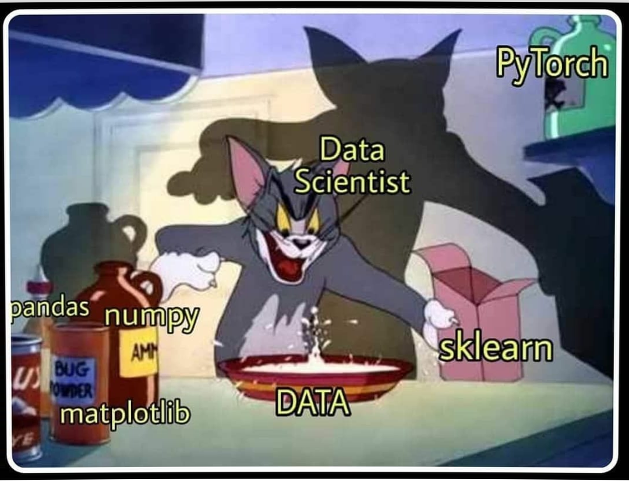
TECHNOLOGY STACK
As aforementioned, we expect you to write non-trivial programmes in Python 3.10 or above
Suggest installing Anaconda distribution for Python
In addition, we will also cover tools such as Git
We recommend using LaTeX for reports through Overleaf
We suggest using a Unix environment for the course
MacOS and Linux distro as already compliant
Install WSL on Windows (recommend dual-booting with a Linux distro such as Ubuntu)
Suggest PyCharm, VS Code, or Data Grip as IDEs for the course
Free access to PyCharm Professional and Data Grip through JetBrains student programme
https://www.jetbrains.com/community/education/
Remember, this is a graduate level CS course, we are expecting the attendant technological maturity
Side note: slides use the Goldman Sans font (https://design.gs.com/foundation/typography/goldman-sans)

Slide 10
Data, raw and unrefined, A treasure trove, but hard to find. But with visualization as our guide, Insights come, and secrets bide. From patterns hidden deep, To trends on the surface, we'll keep. Big data's value, now clear to see, Thanks to visualization's key. It helps us make sense, Of this complex dense. And with it, we can tell a story, Of data's true worth and its glory.
- ChatGPT

Slide 11
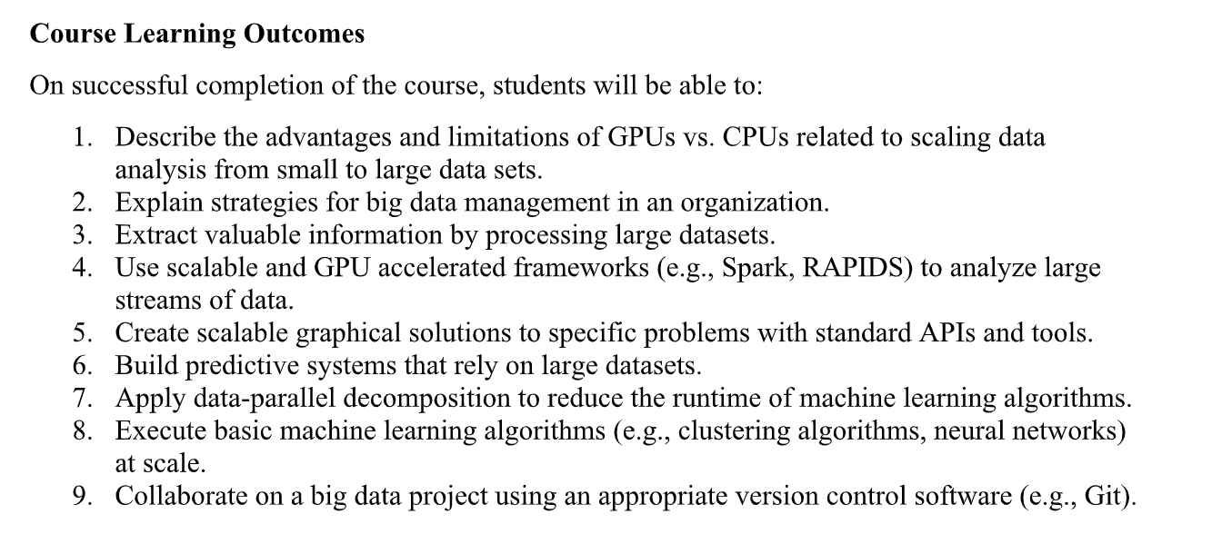

Slide 12
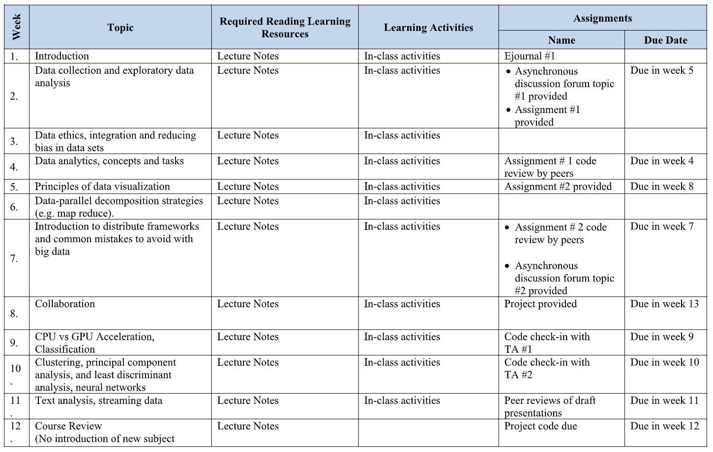

Slide 13
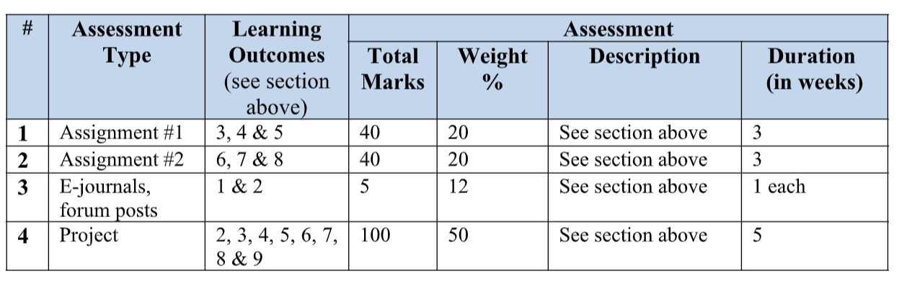

Slide 14
BIG DATA
Rate of data production across all industries and human activities is rapidly increasingly every year
Data generated from multiple sources
Rapidly accumulated is large and complex
Constellation of integrated traits emerges
The 6 V’s of Big Data

Slide 15
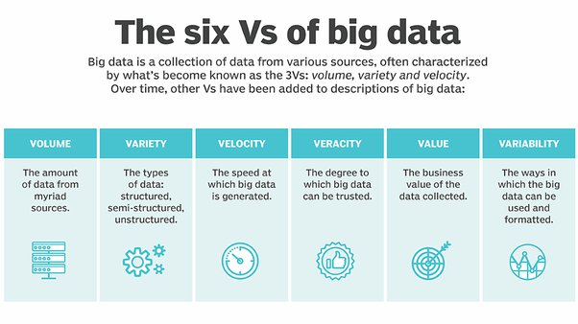

Slide 16
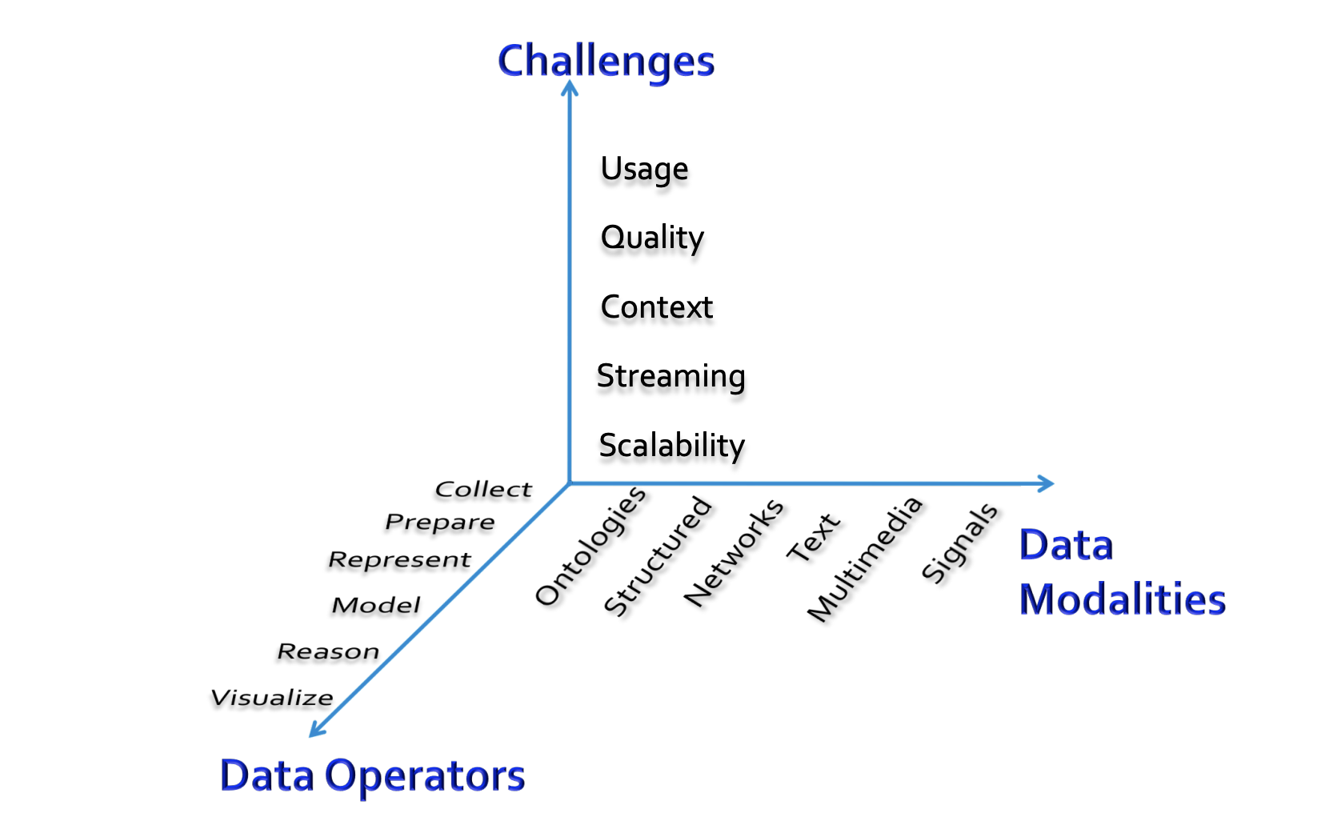
CONSIDERATIONS WHEN WORKING WITH BIG DATA

Slide 17
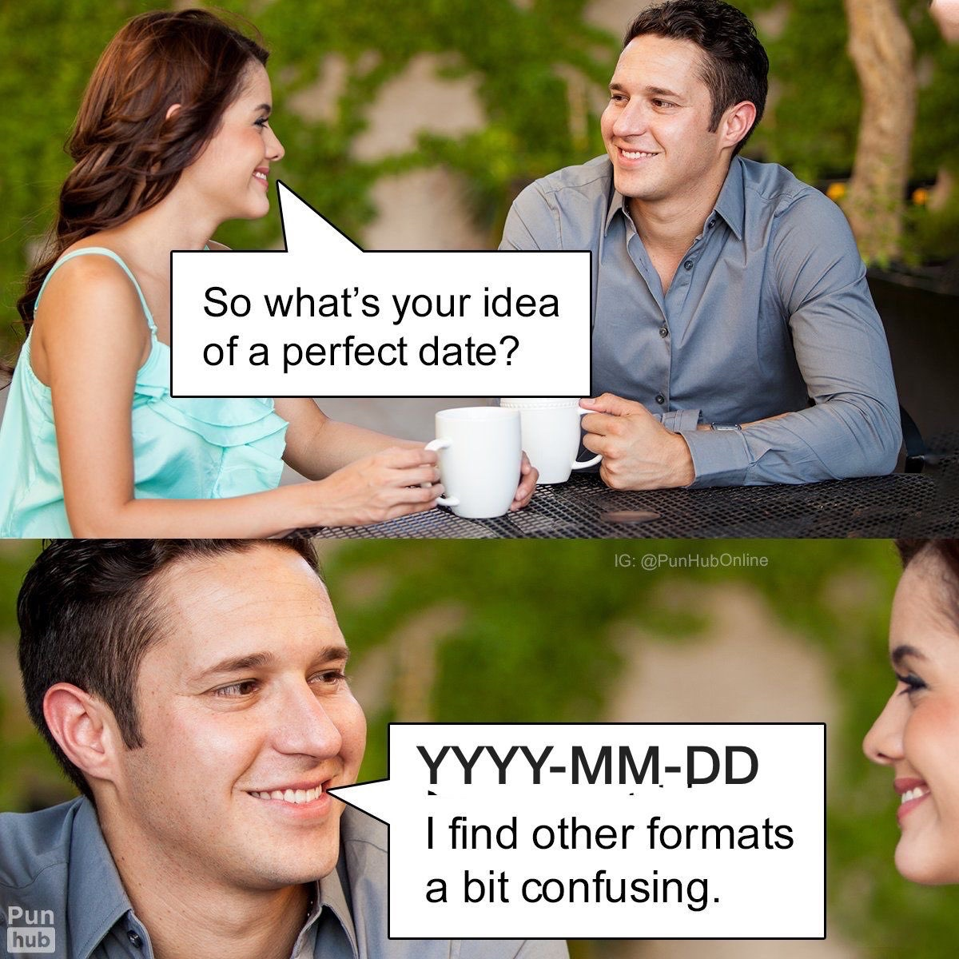
BIG DATA – DATA CLEANING
Data from source systems are almost always messy and legion with issues that hamper correct usage
Form validation didn’t exist as we know it today in the 70’s
Inconsistent and erroneous formats, e.g. DDMMYY and MMDDYY in the same data field
Would discuss more on data cleaning next lecture

Slide 18

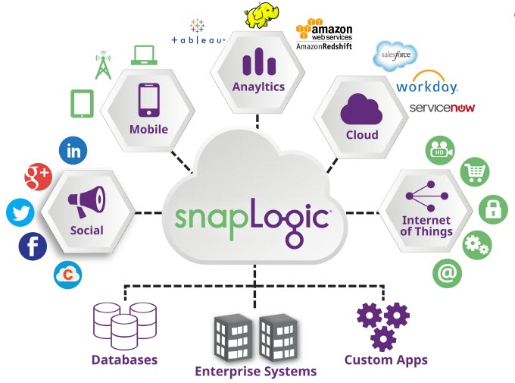
BIG DATA – ETL
Extract: data is pulled from required source systems and databases
Transform: data is cleaned and otherwise transformed from source sytems
Load: transformed data is loaded into format or storage amenable to analysis and additional processing for data mining (next slide)
Files (e.g. Feather, CSV, etc…)
Data Warehouses/Data Lakes (e.g. Snowflake)
Several tools for ETL (Apache Airflow, SnapLogic)
In reverse ETL, data is piped from the load area back to the source areas from which the data is extracted

Slide 19
BIG DATA – DATA MINING
Goal of data mining is to extract patterns from large quantities of data and build models that allow us to make predictions of the data
Data Mining can be split into
Descriptive: characterize patterns in the data, e.g. clustering for customer segments, stream processing for computing live statistics
Predictive: develop models to predict unknown or future values of some variable, e.g. predicting risk of churn, recommender systems to recommend products
At best data mining produces results that are:
Valid: patterns and models are representative of current and future state respectively
Useful/Actionable: possible to use descriptive or predictive insights
Unexpected/Interesting: results are non-trivial
Understandable/Explainable: results can be interpreted and understood by human beings
Will discuss some good practices in detail in later lectures

Slide 20
BIG DATA – DATA MINING
Suppose we want to increase sales. Number of sales would be KPI
We want to increase this KPI
One way would be more tailored marketing strategies to most valuable segments (i.e. lever)
Data Mining can help us determine segments from dataset to support and enable business lever
Data Mining is essential tool in digital transformation
Good data science, often involves hypotheses – don’t just throw random modelling techniques at data and see what sticks

Slide 21
DATA VISUALIZATION
Results from data analysis would need to be communicated to stakeholders or fellow researchers
Data visualization is concerned with pictographically and diagrammatically representing important trends in the data
Often with charts that represent the relationships between different quantities in the data
Good visualizations:
Correct: correctly encode the data from the dataset
Honest: are created without the intention of misleading the audience
Visually appealing: should not use garish and distracting palletes or organization

Slide 22
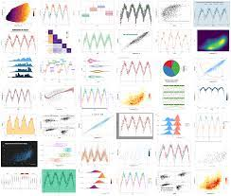


DATA VISUALIZATION
Many different chart types for data viz:
Pie, Line, Box plot, etc….
Visualizations can be standalone or can be embedded in a dashboard to assist in decision making
Tools for creating visualizations:
JavaScript – D3
R – ggplot
Python – Matplotlib, Seaborn, Plotnone (ggplot in Python)
Dashboards – Tableu, PowerBI

Slide 23
BUILDING BLOCKS OF DATA MINING PRACTICE
Collection
Cleaning
Integration
EDA/CDA
Visualization
Modelling
Presentation/Dissemination

Slide 24
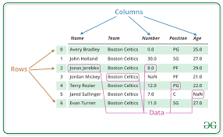
DATAFRAMES
Many datasets would be either natively tabular or can be massaged into being tabular
Most ML/DS libraries expect tabular formats
Dataframes are common abstract data type for working with data in a tabular format
Many different implementations:
Pandas
Polrs
Dask
Offer:
Data indexing
Data selection and filtering
Creation and update of columns
Etc…

Slide 25
SELF DEVELOPMENT
Main scientific conferences/journals: KDD, WebConf, ICDM, IEEE BigData, ASONAM, CHI, RecSys, TKDE, etc…
TowardsDataScience: medium blog channel. Lots of great ideas – also loads of nonsense. Always read critically
Reddit – r/datascience and r/machinelearning are pretty good places to learn of new technologies and approaches

Slide 26
E-JOURNAL #1
Graphs are becoming increasingly important data structures and abstractions in data mining and big data, thereby leading to the sub-field of graph mining. Research and reflect on this trend and its implications
Due next week Friday @ 11:59 PM (AoE)

Slide 27
QUESTIONS?

Slide 28
IMAGE CREDITS
SLIDE 5: https://www.wired.com/insights/2014/07/data-new-oil-digital-economy/
SLIDE 8 & 15: r/DataScienceMemes
SLIDE 13: https://www.quora.com/What-are-the-six-Vs-of-Big-Data
SLIDE 14: http://www.mmds.org/mmds/v2.1/ch01-intro.pdf
SLIDE 16b: https://siliconangle.com/2017/02/15/snaplogic-expands-cloud-app-kafka-real-time-support-new-release/
Slide 22: https://www.geeksforgeeks.org/python-pandas-dataframe/

